Slide 1
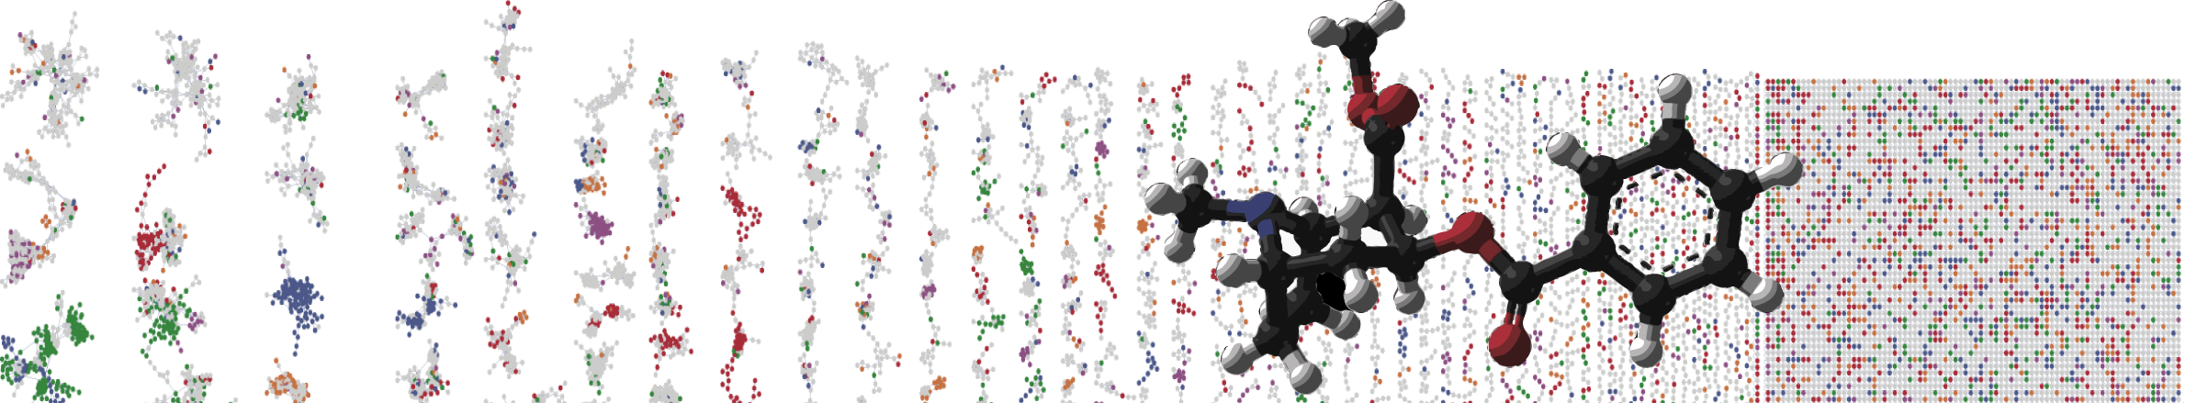


ReDu – A Repository-scale Co- and Re-analysis of Tandem Mass Spectrometry Data
Overview
PRESENTER’S NAME
University of California - San Diego

Slide 2

Repository-scale Co- and Re-analysis of Tandem Mass Spectrometry Data
ReDU is a community- and data-driven approach to find and reuse public data containing tandem MS data at the repository scale.
ReDU is a launchpad for co- or re-analysis of public data via the GNPS platform.
Our aim is to empower researchers to put their data in the context of public data as well as explore questions using public data at the repository scale.
Repository-scale Co- and Re-analysis of Tandem Mass Spectrometry Data
[https://www.biorxiv.org/content/10.1101/750471v1]

Slide 3

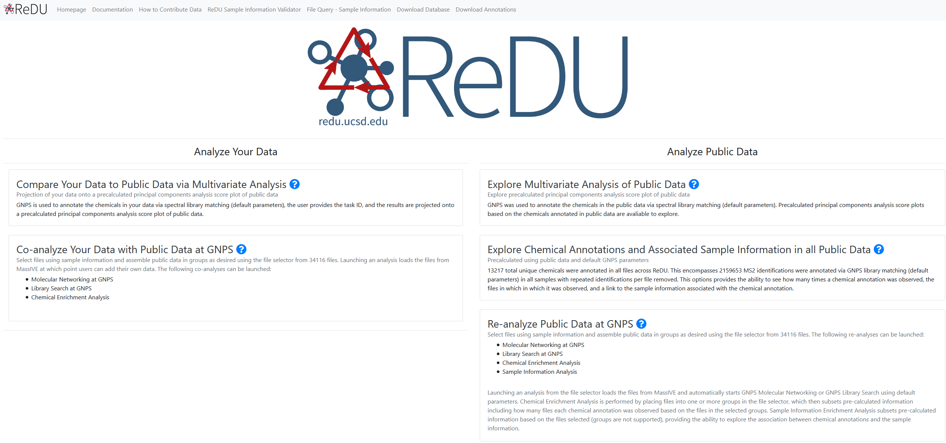

Slide 4
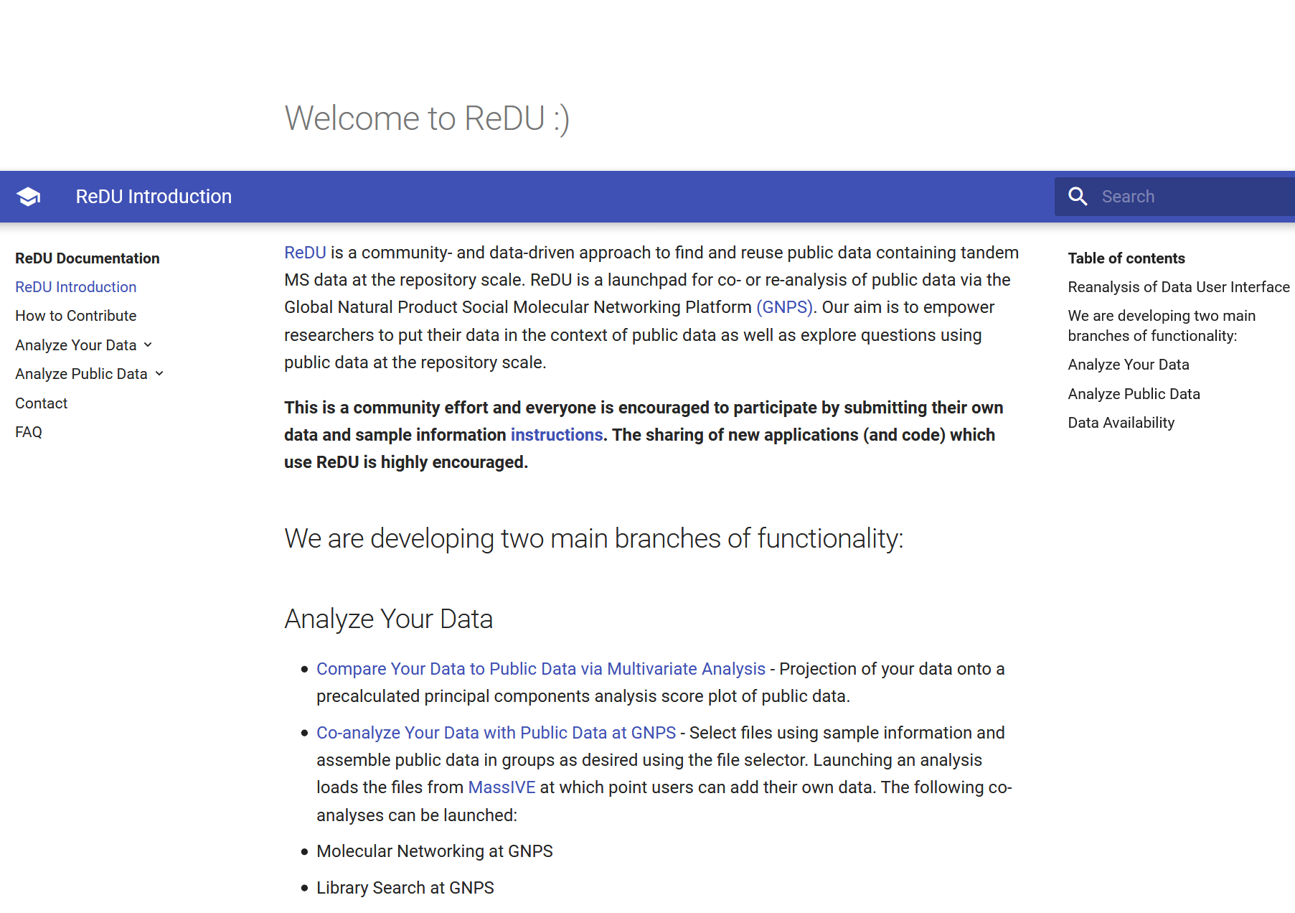
Documentation

Slide 5
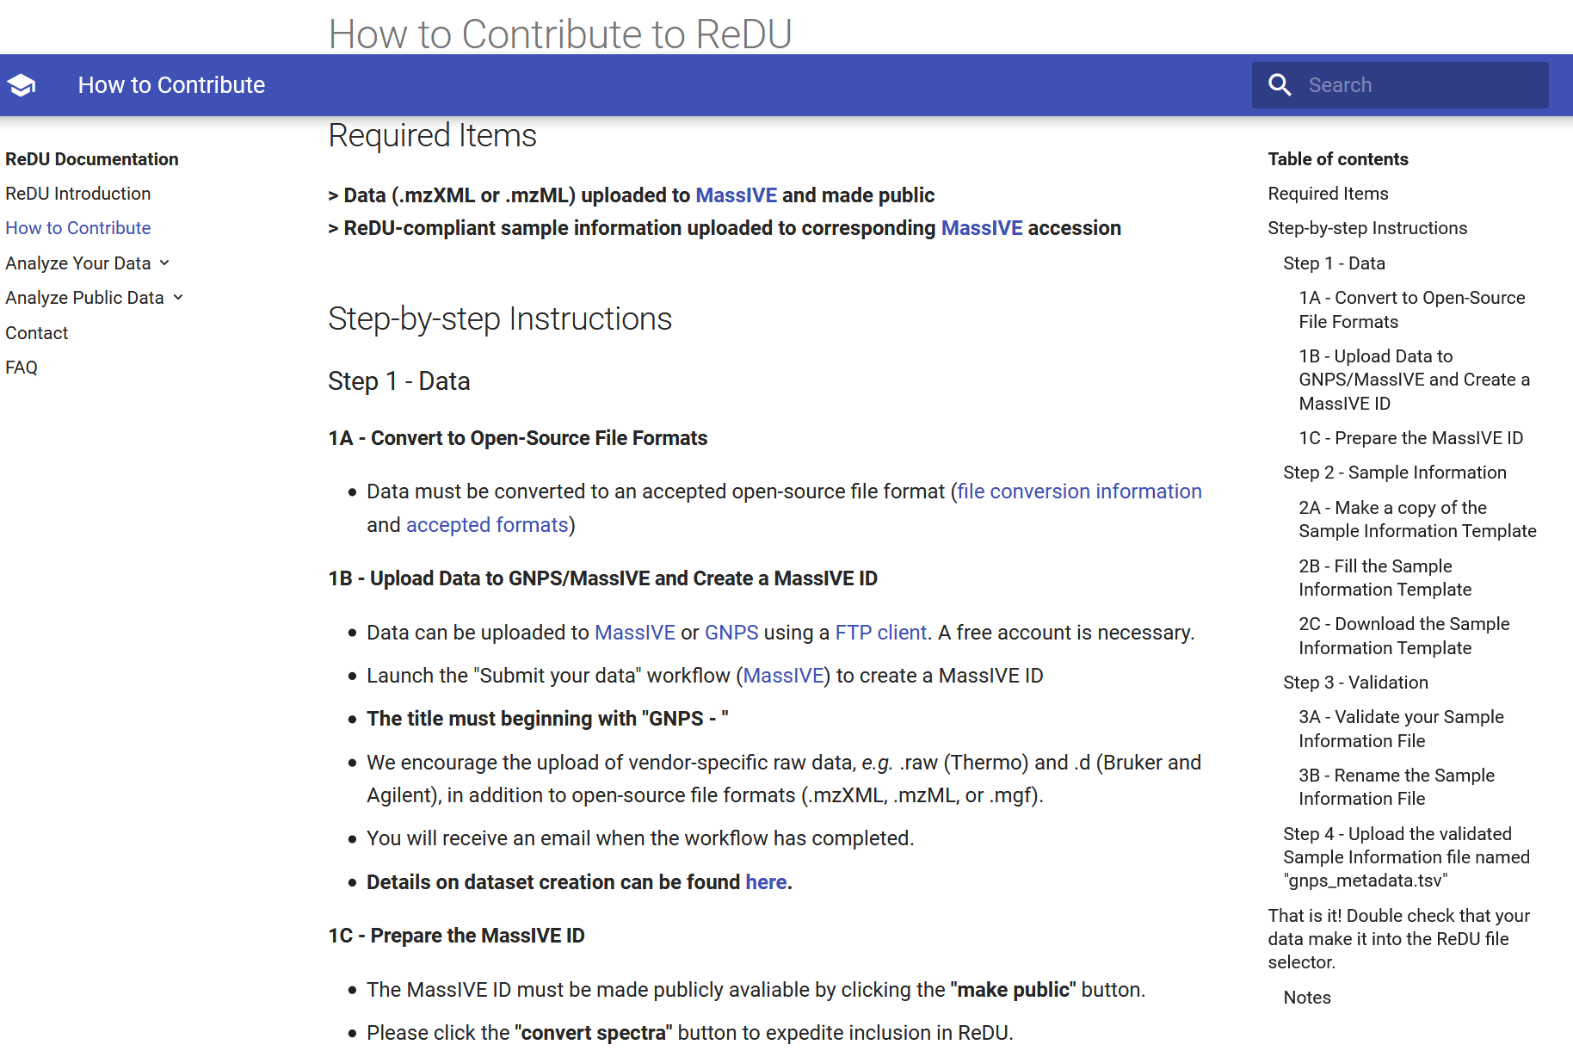
How to contribute to ReDu
Scroll down for more

Slide 6
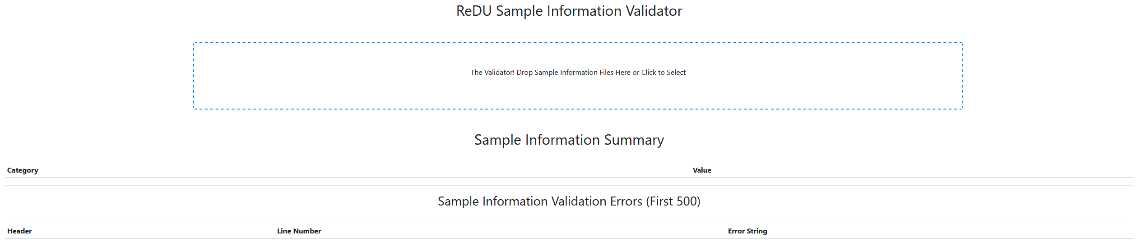
ReDu Sample Information Validator
Drag and drop files or just click to select

Slide 7
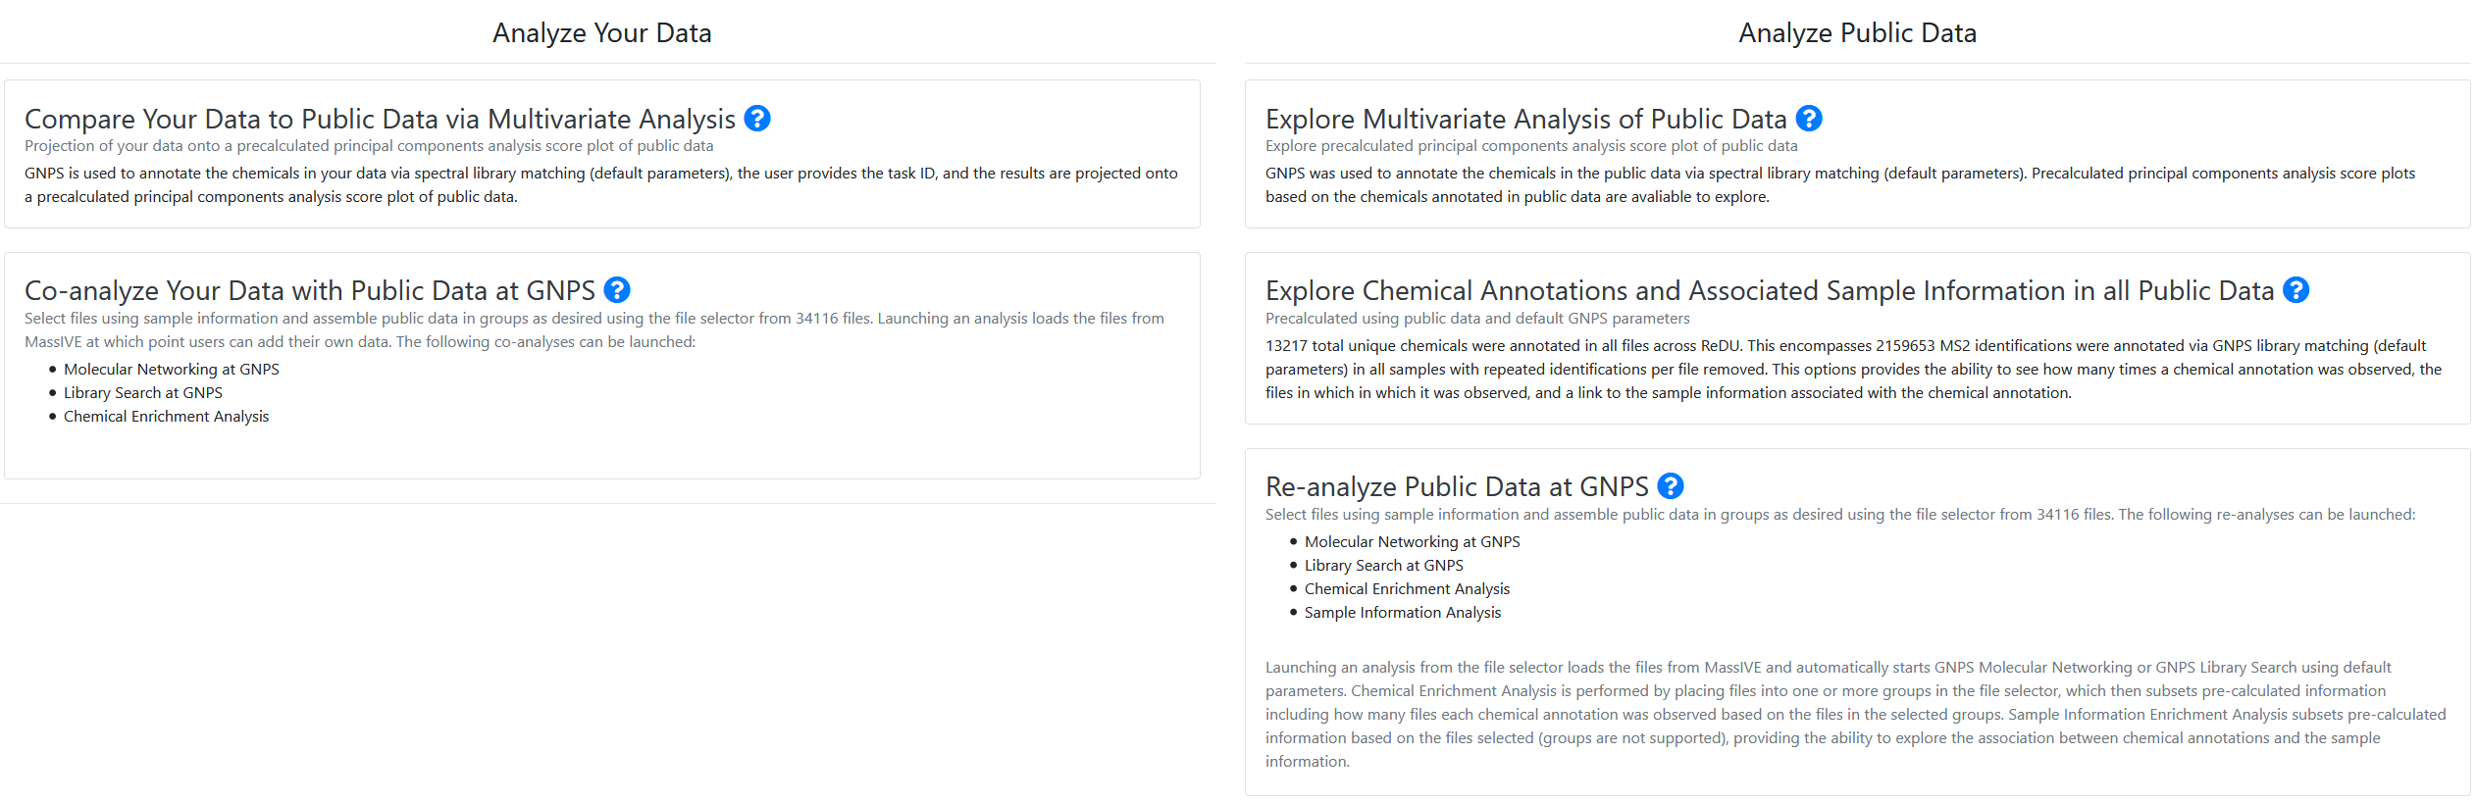
Analyze your data

Slide 8
Analyze your data

Slide 9
Analyze your data

Slide 10
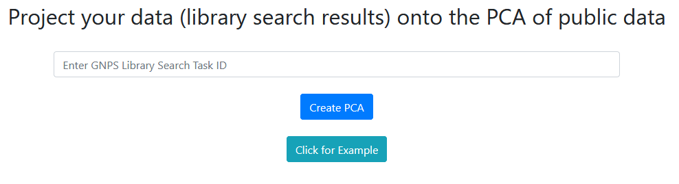
Analyze your data
The annotations in your data are used to “project” your data onto the PCA coordinate frame of the public data

Slide 11
Analyze your data
2.
1. Enter task ID from classical molecular networking, library search, or feature-based molecular networking

Slide 12
Analyze your data
Or just click for an example

Slide 13
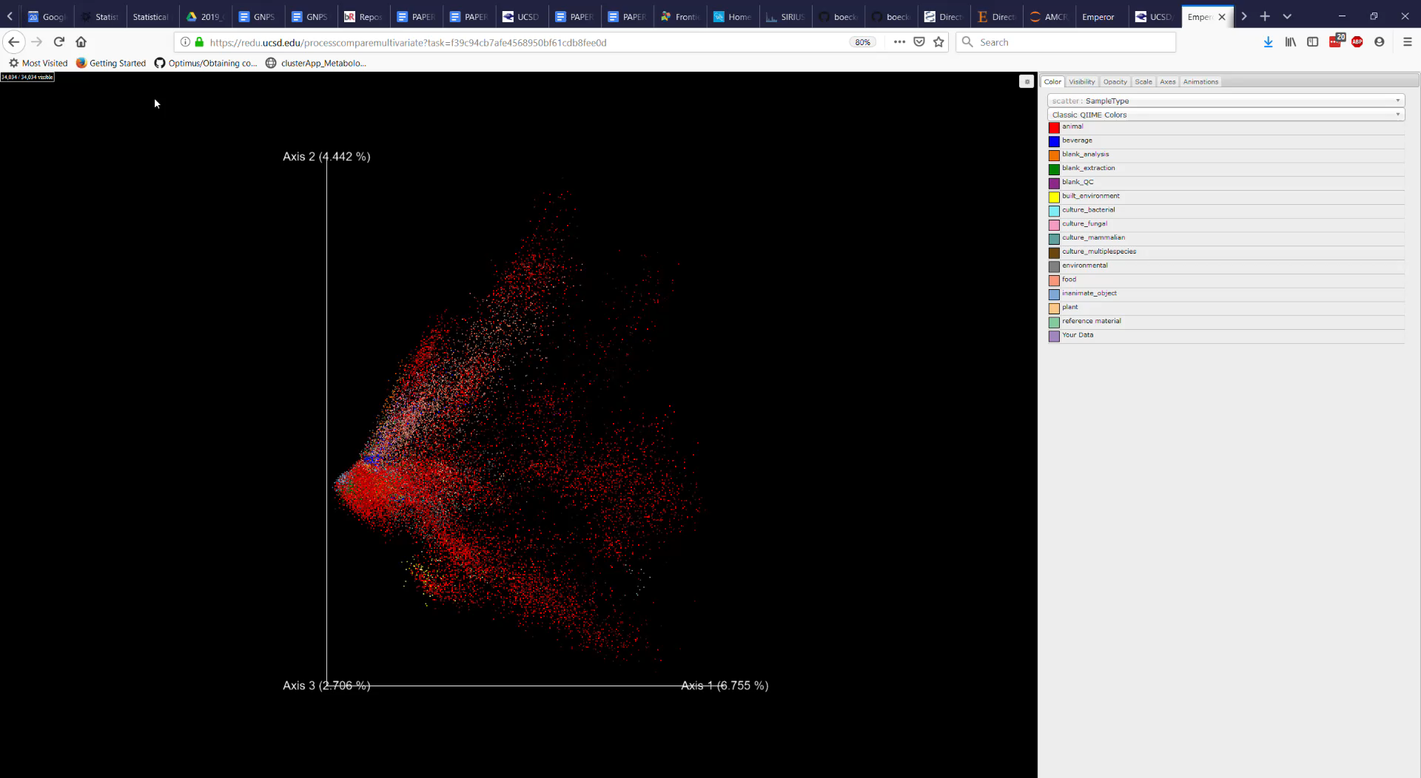
Analyze your data

Slide 14
Analyze your data

Slide 15
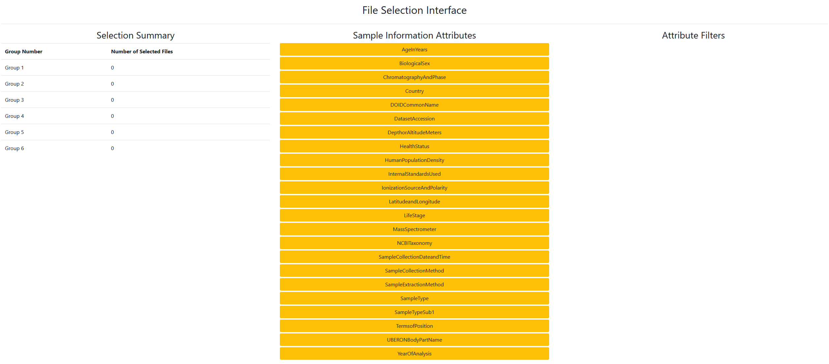
Analyze your data
Group composition information
Filter

Slide 16
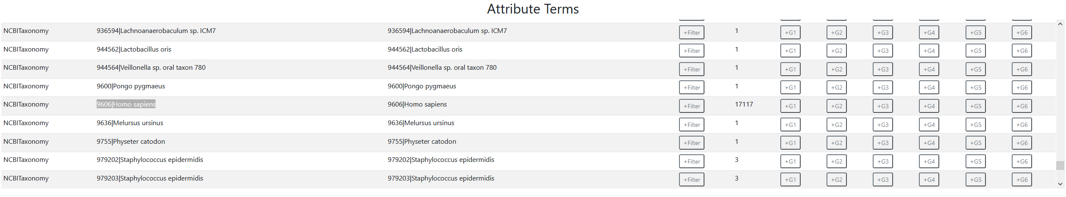
Analyze your data
Scroll down and you will visualize the groups you want to select
Filter

Slide 17
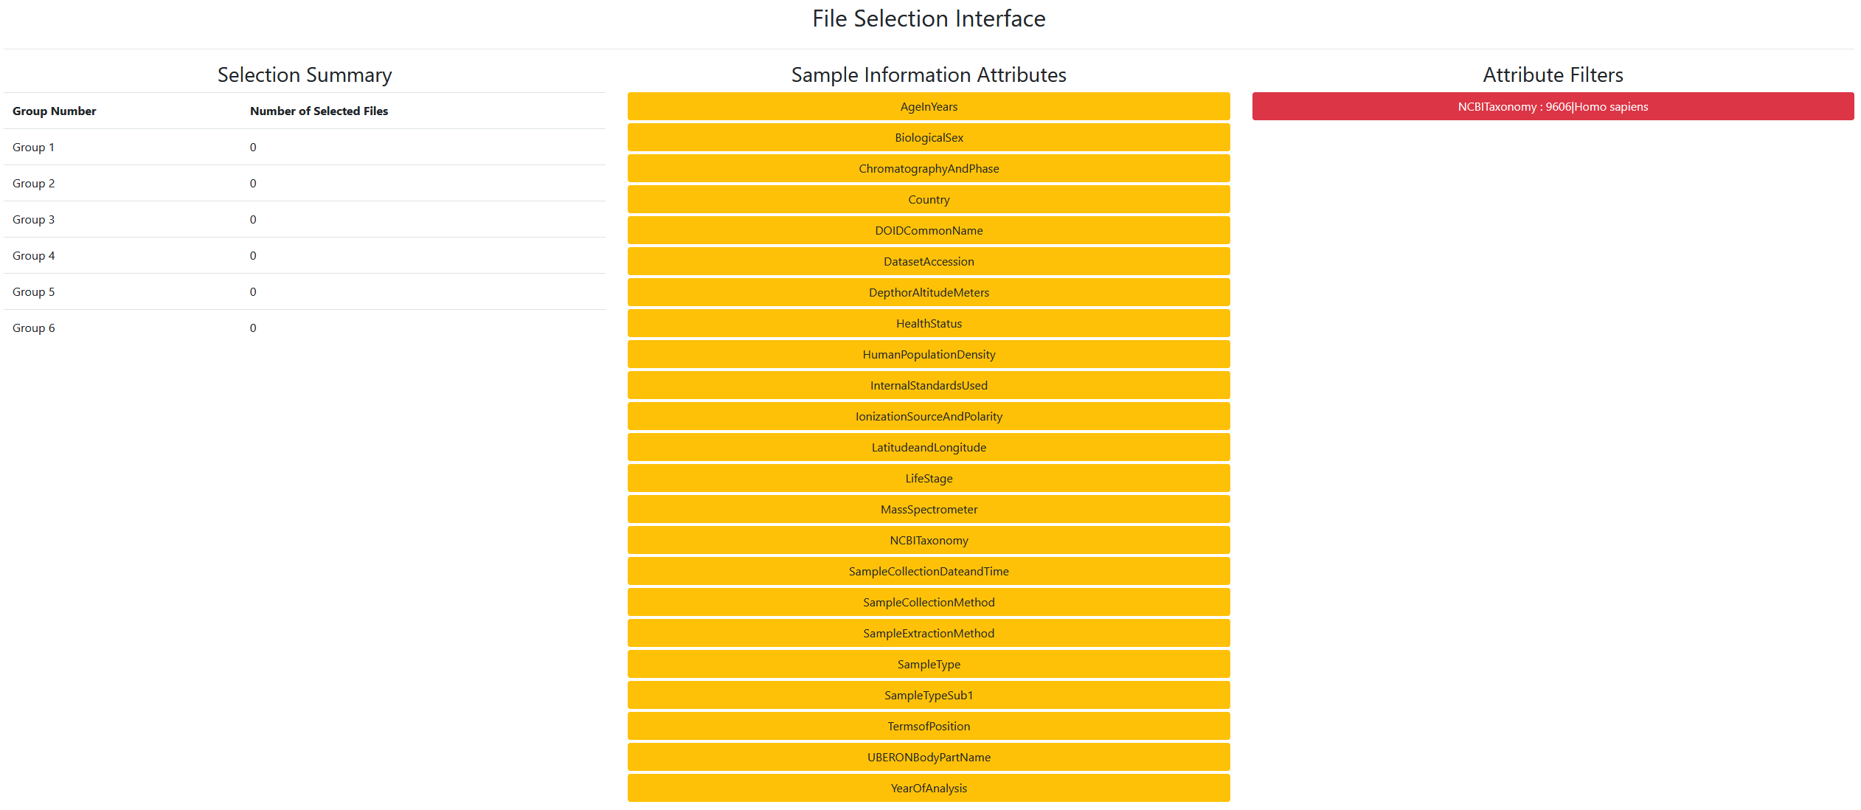
Analyze your data
The applied filter is shown

Slide 18
Analyze your data
Now select the Attributes you want to use to co-analyze your data

Slide 19
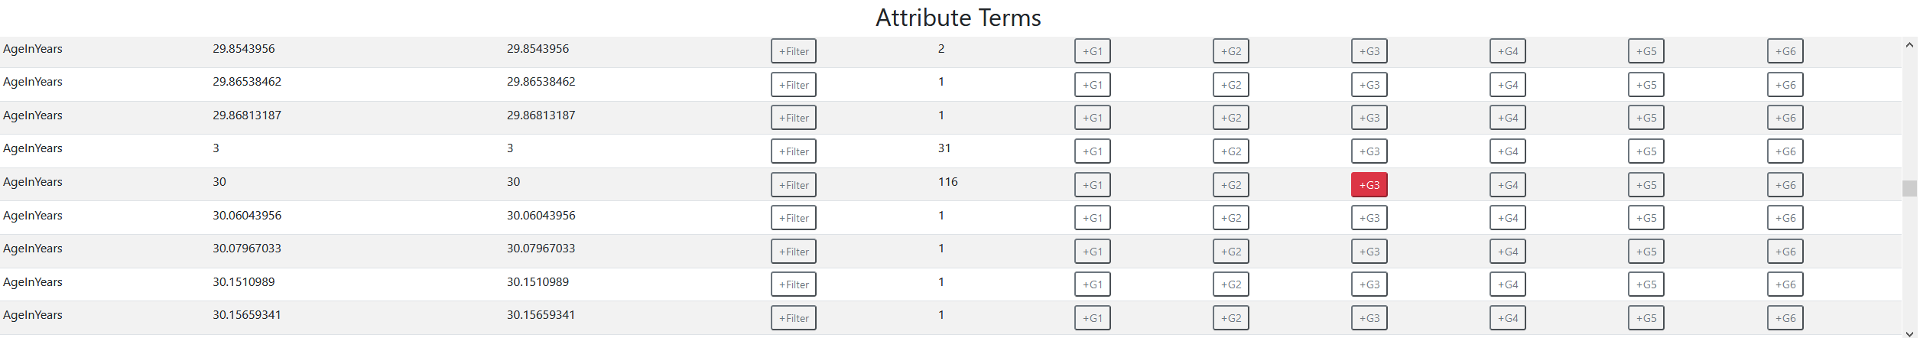
Analyze your data
Add files to groups (G1 – G6)

Slide 20
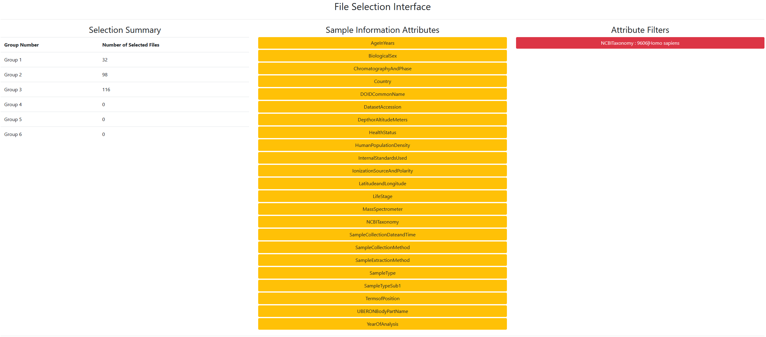
Analyze your data
Co-Analysis: The file selector is used to find files for subsequent analysis using molecular networking or library search
Group composition information
Sample information filter options

Slide 21
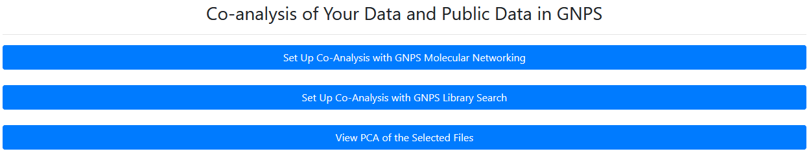
Analyze your data

Slide 22
Analyze your data

Slide 23
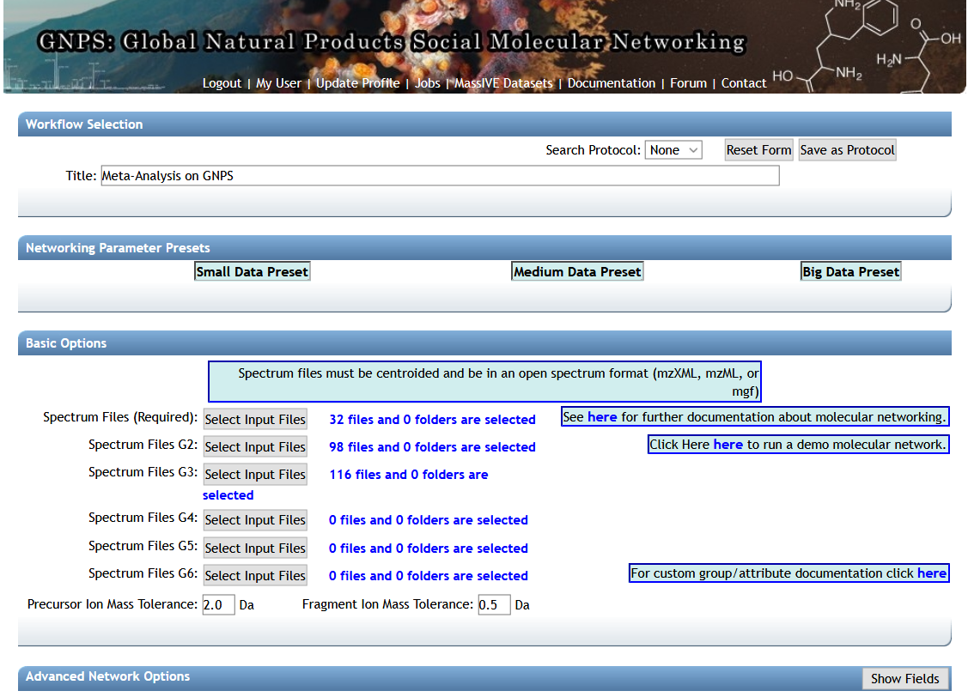
Analyze your data
Include your data

Slide 24
Analyze your data

Slide 25
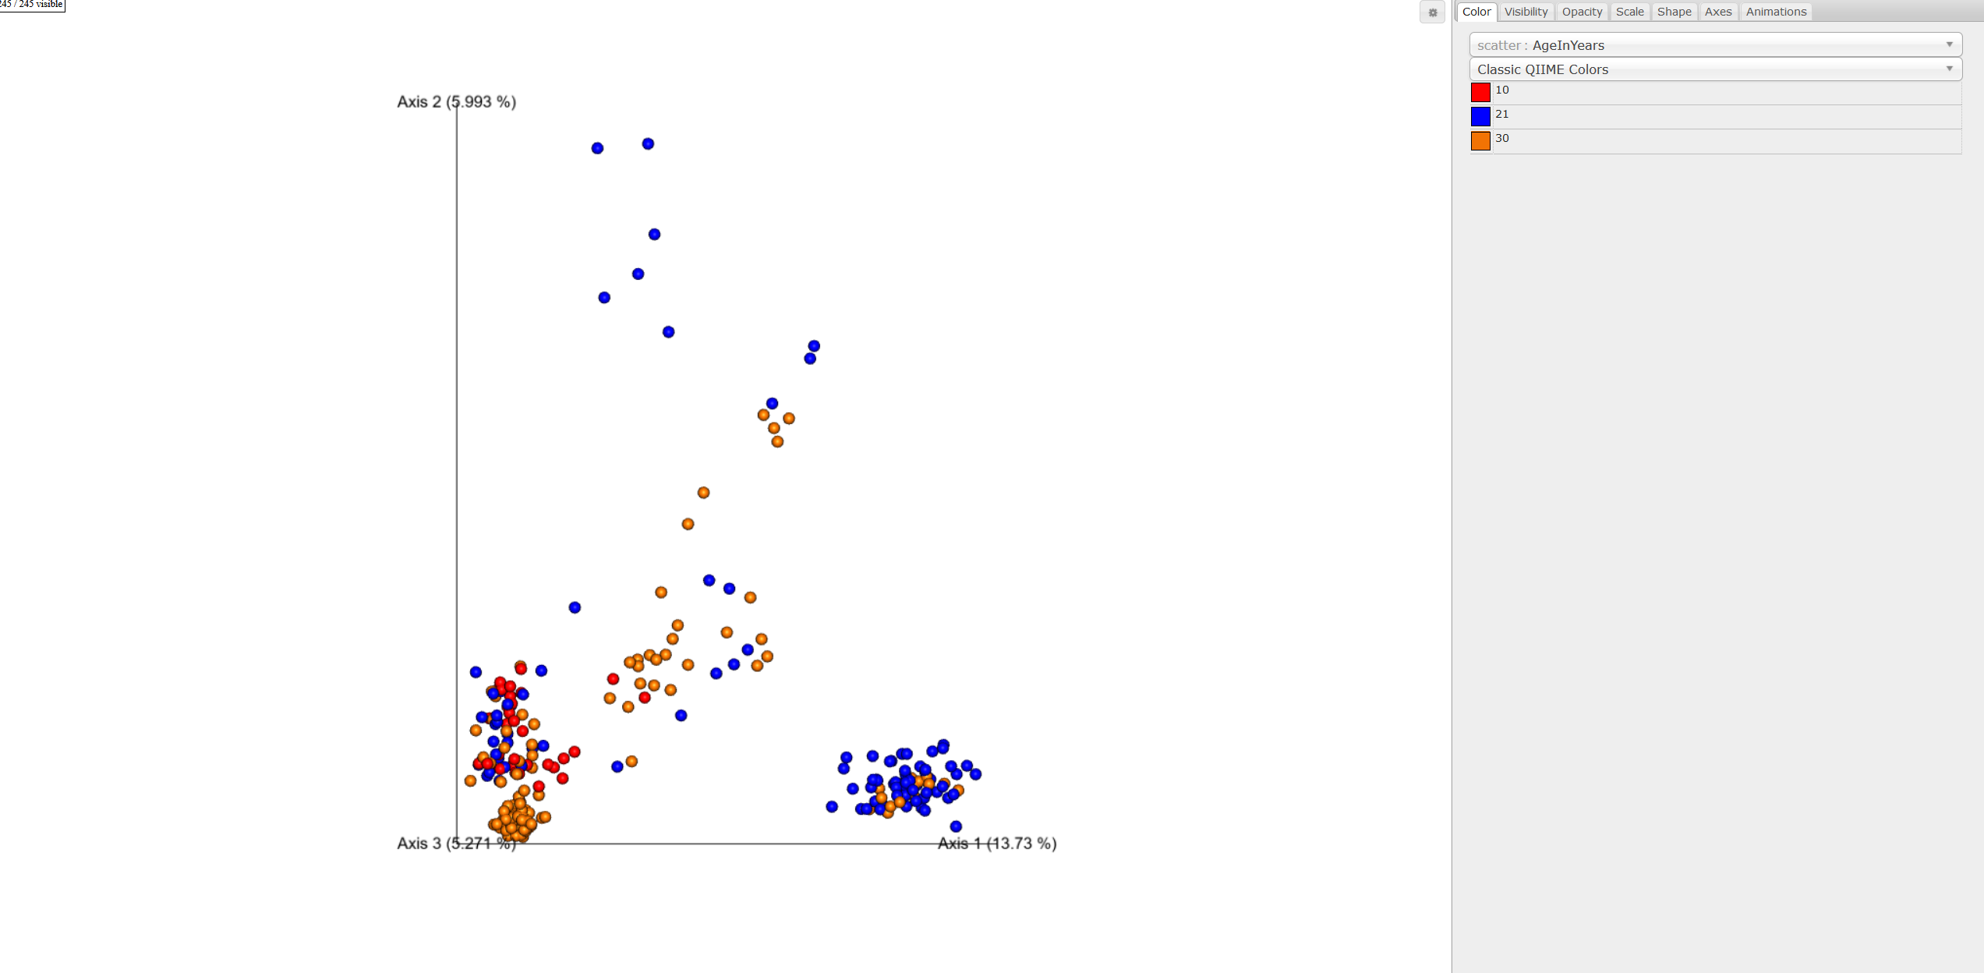
Analyze your data
Another variable might drive this separation

Slide 26
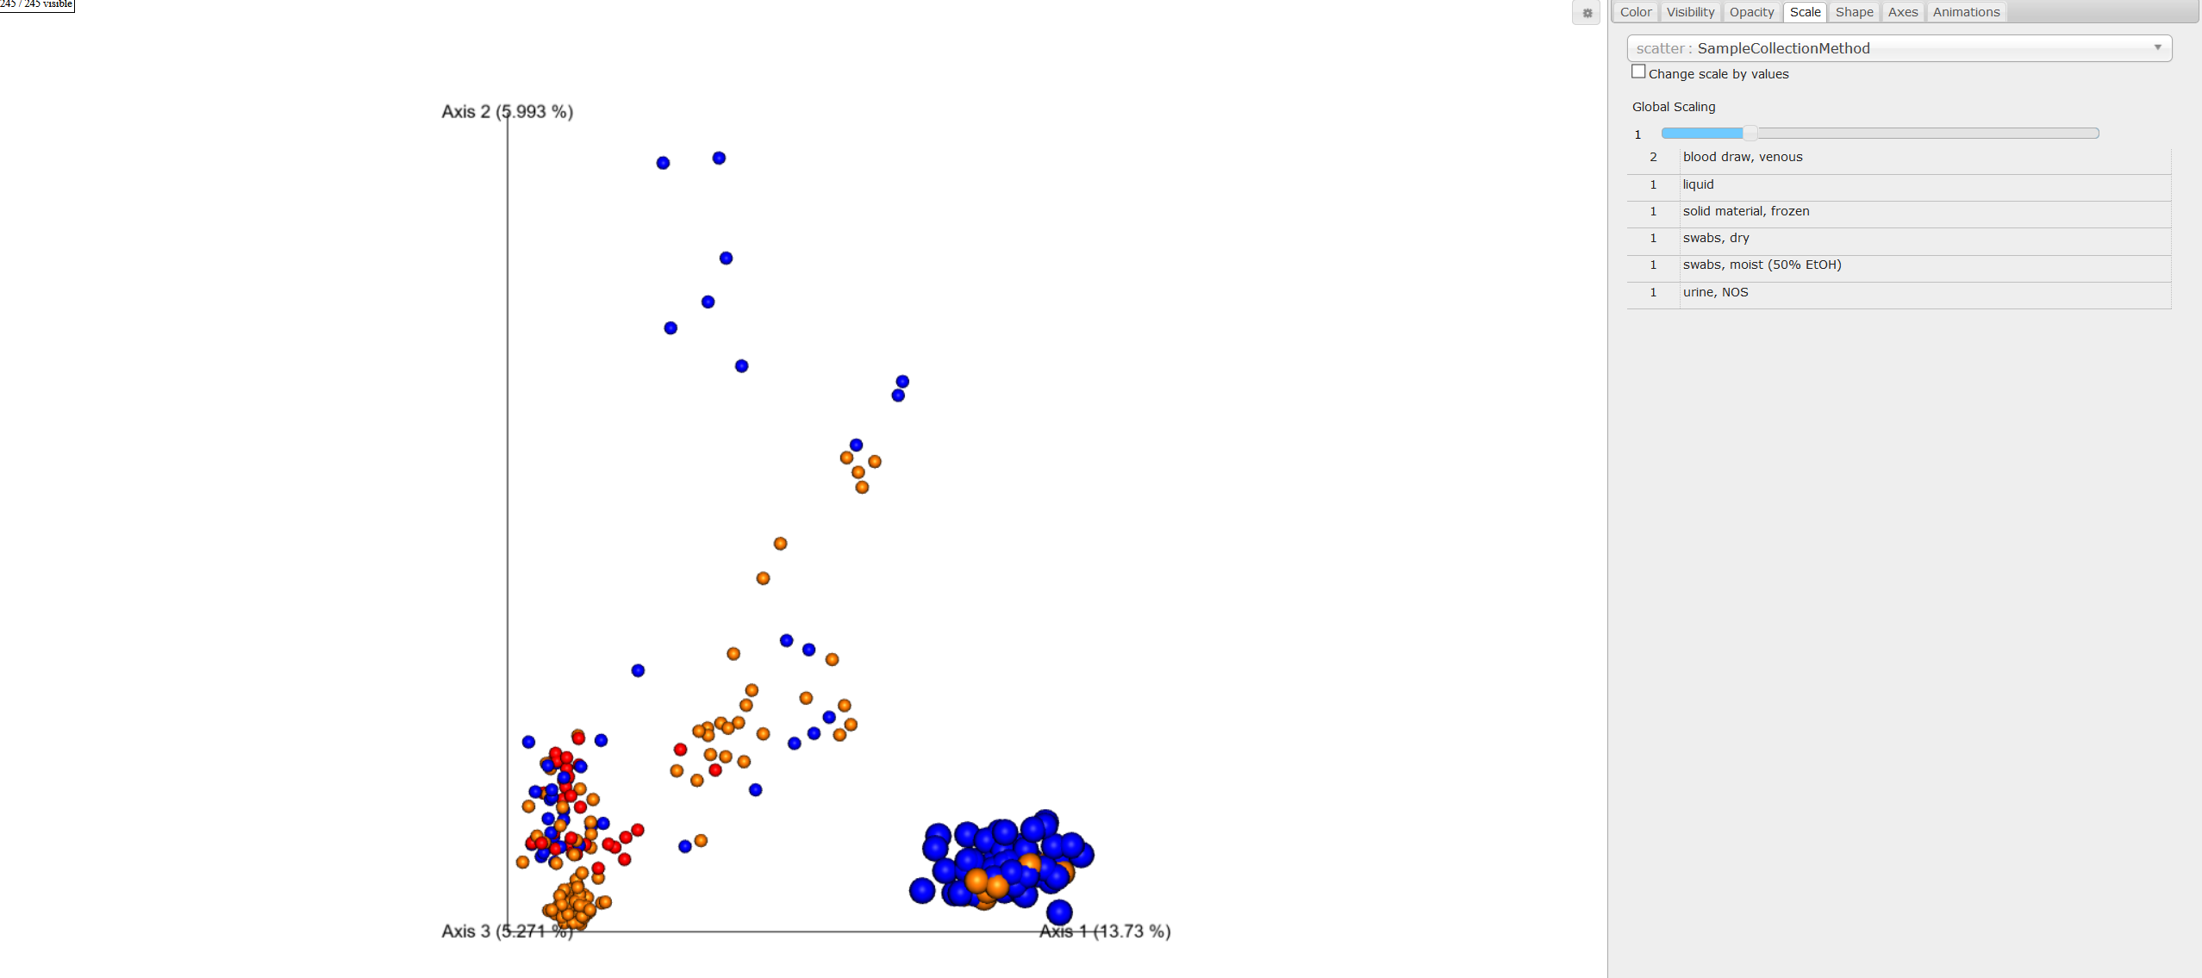
Analyze your data
Sample Collection Method
“Blood draw, venous” drives this separation

Slide 27
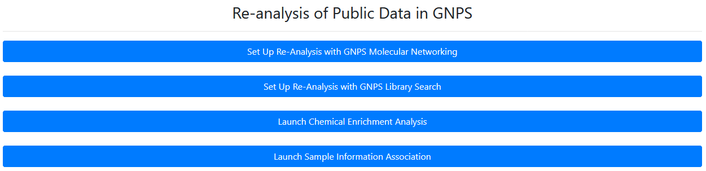
Re-analysis of public data: Chemical enrichment

Slide 28
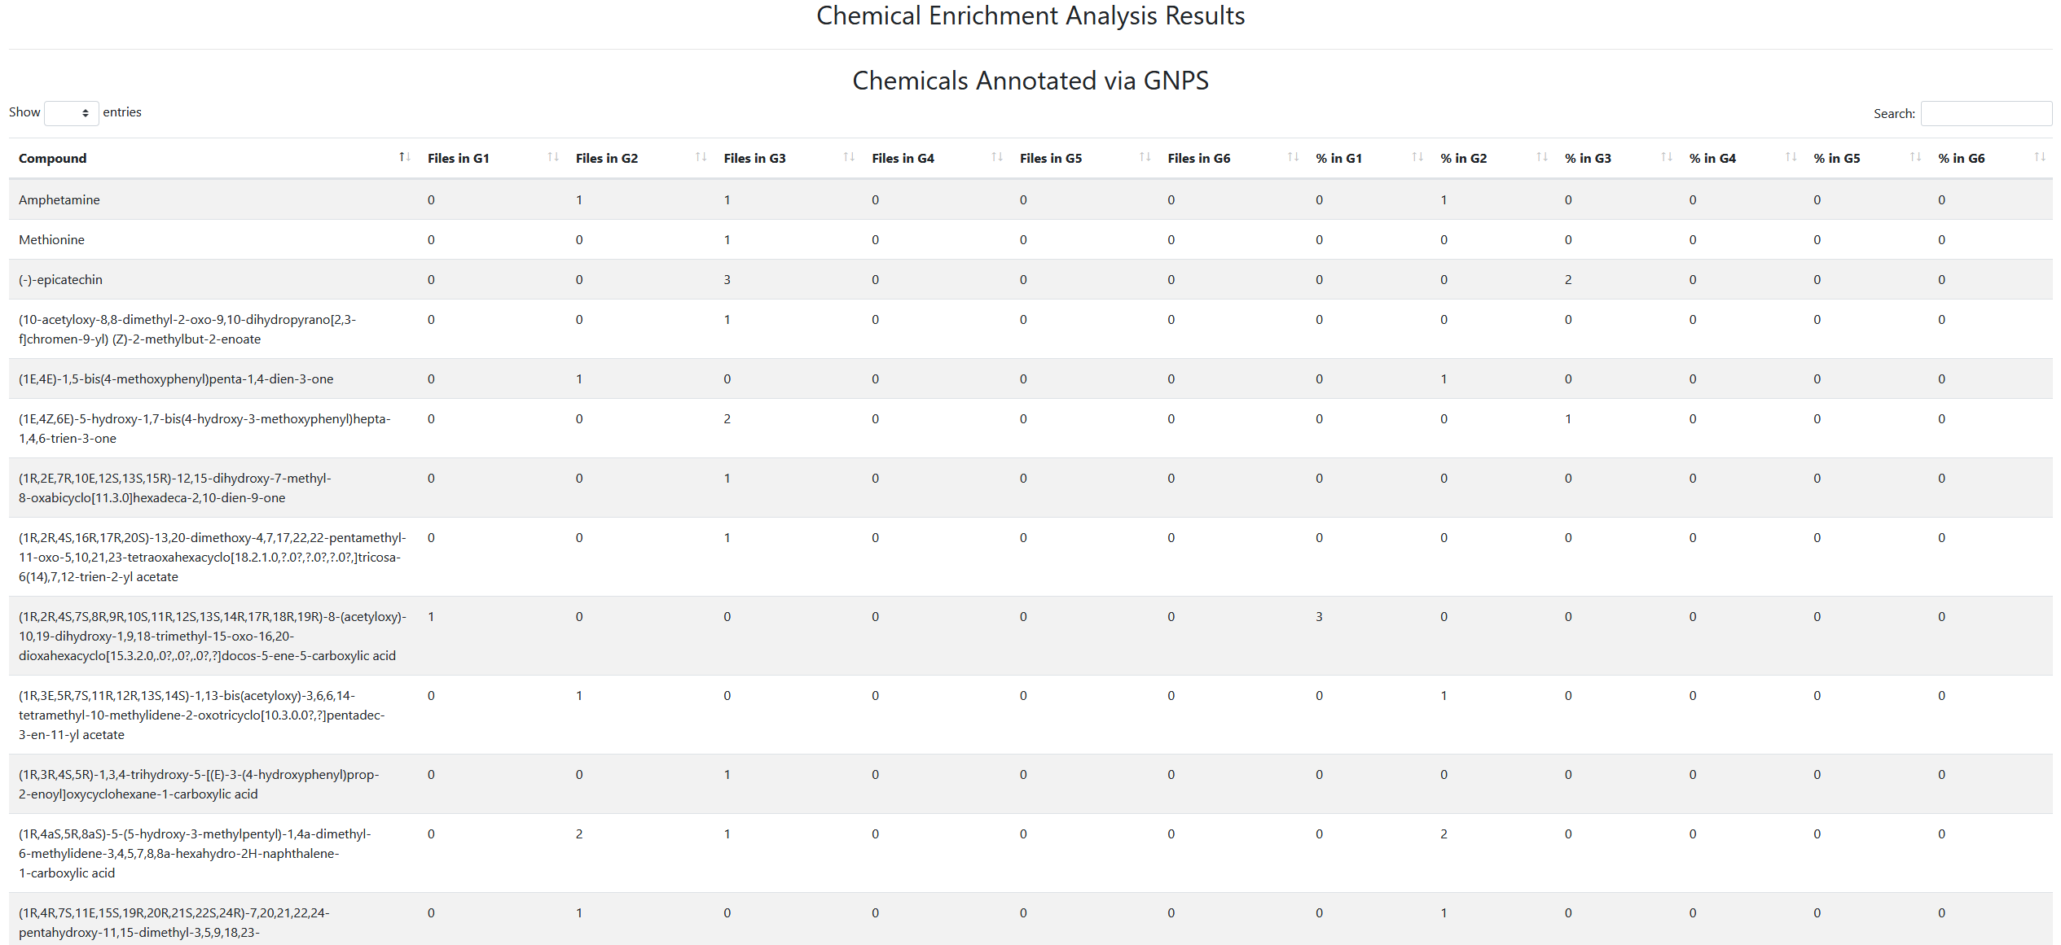
Re-analysis of public data: Chemical enrichment

Slide 29
Re-analysis of public data: Chemical enrichment

Slide 30
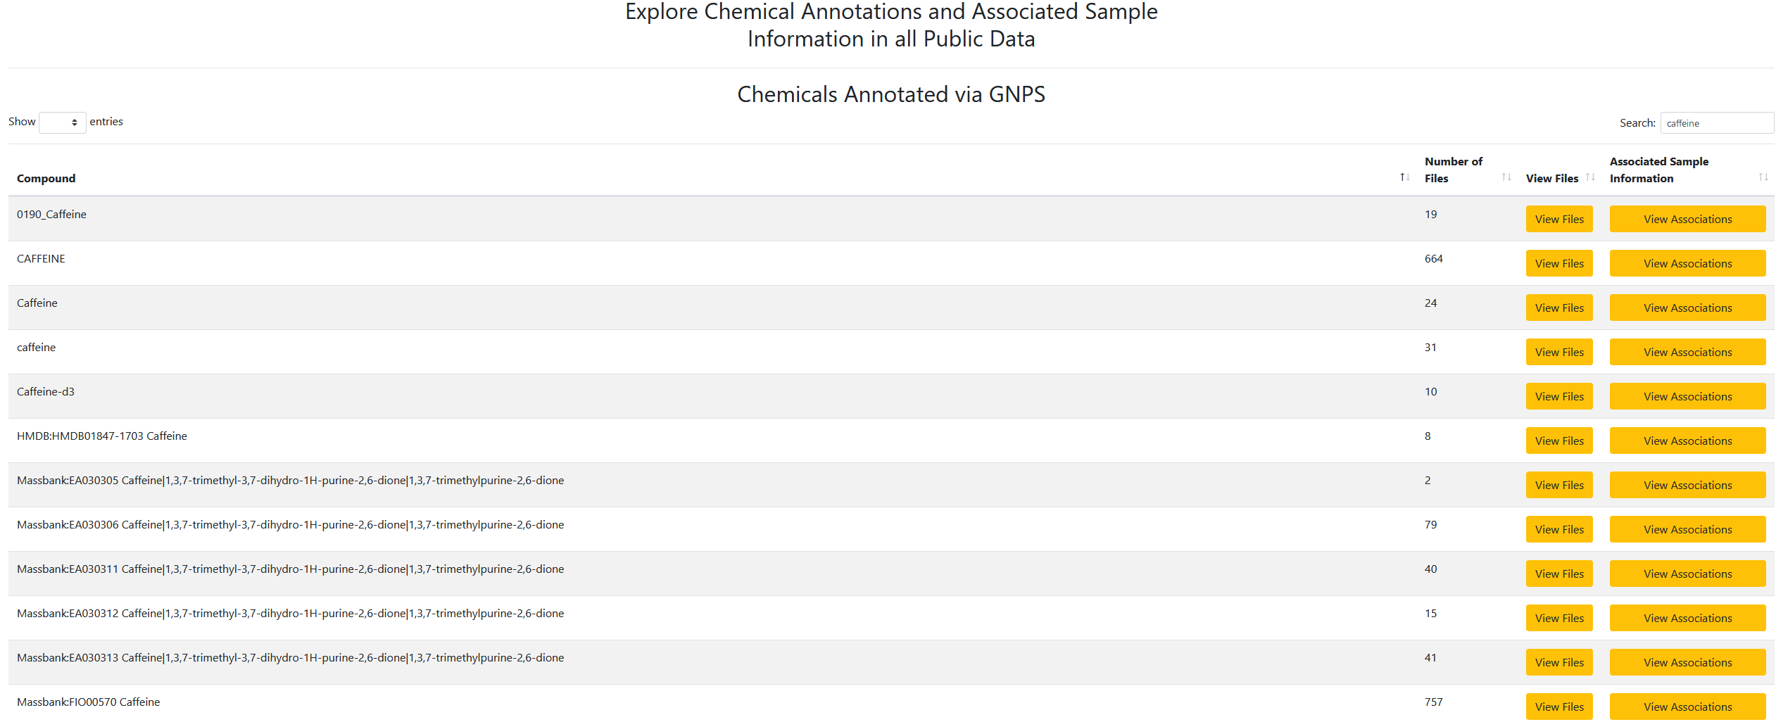
Re-analysis of public data: Sample information enrichment

Slide 31

Questions, Problems or Bugs?
Documentation: https://ccms-ucsd.github.io/GNPSDocumentation/
Forum: https://groups.google.com/forum/#!forum/molecular_networking_bug_reports
PRESENTER’S NAME
E-mail

